Slide 1
Matrix
李宏毅
Hung-yi Lee

Slide 2





Matrix
A matrix is a set of vectors
$$a_{1}=\left[\begin{matrix}2 \\ 3 \\ −2\end{matrix}\right]$$
$$a_{2}=\left[\begin{matrix}3 \\ 1 \\ 1\end{matrix}\right]$$
$$a_{3}=\left[\begin{matrix}5 \\ −1 \\ 1\end{matrix}\right]$$
$$=\left[\begin{matrix}2 & 3 & 5 \\ 3 & 1 & −1 \\ −2 & 1 & 1\end{matrix}\right]$$
$$A=\left[\begin{matrix}a_{1} & a_{2} & a_{3}\end{matrix}\right]$$

Slide 3


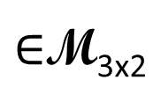
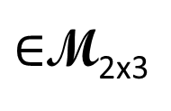
Matrix
If the matrix has m rows and n columns, we say the size of the matrix is m by n, written m x n
The matrix is called square if m=n
We use M_{mxn} to denote the set that contains all matrices whose size is m x n
2 columns
3 columns
$$\left[\begin{matrix}1 & 4 \\ 2 & 5 \\ 3 & 6\end{matrix}\right]$$
2 rows
$$\left[\begin{matrix}1 & 2 & 3 \\ 4 & 5 & 6\end{matrix}\right]$$
3 rows
$∈$M_{3x2}
$∈$M_{2x3}
2 X 3
3 X 2
先 Row 再 Column

Slide 4

Matrix
Index of component: the scalar in the i-th row and j-th column is called (i,j)-entry of the matrix
(1,2)-entry
$$A=\left[\begin{matrix}2 & 3 & 5 \\ 3 & 1 & −1 \\ −2 & 1 & 1\end{matrix}\right]$$
(3,1)-entry
先 Row 再 Column
(3,3)-entry

Slide 5





Matrix
Two matrices with the same size can add or subtract.
Matrix can multiply by a scalar
$$A=\left[\begin{matrix}1 & 4 \\ 2 & 5 \\ 3 & 6\end{matrix}\right]$$
$$B=\left[\begin{matrix}6 & 9 \\ 8 & 0 \\ 9 & 2\end{matrix}\right]$$
$$9B=\left[\begin{matrix}54 & 81 \\ 72 & 0 \\ 81 & 18\end{matrix}\right]$$
$$A+B=\left[\begin{matrix}7 & 13 \\ 10 & 5 \\ 12 & 8\end{matrix}\right]$$
$$A−B=\left[\begin{matrix}−5 & −5 \\ −6 & −5 \\ −6 & 4\end{matrix}\right]$$

Slide 6



Zero Matrix
zero matrix: matrix with all zero entries, denoted by O (any size) or O_{m×n}.
For example, a 2-by-3 zero matrix can be denoted
Identity matrix: must be square
對角線是 1, 其它都是 0
$$A+O=A$$
$$0A=O$$
$$A−A=O$$
Sometimes I_{n} is simply written as I (any size).

Slide 7
Properties
A, B, C are mxn matrices, and s and t are scalars
A + B = B + A
(A + B) + C = A + (B + C)
(st)A = s(tA)
s(A + B) = sA + sB
(s+t)A = sA + tA

Slide 8

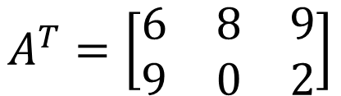

Transpose
Is “transpose” a linear system?
If A is an mxn matrix
$A^{T}$ (transpose of A) is an nxm matrix whose (i,j)-entry is the (j-i)-entry of A
(1,2)
$$A=\left[\begin{matrix}6 & 9 \\ 8 & 0 \\ 9 & 2\end{matrix}\right]$$
Transpose
$$A^{T}=\left[\begin{matrix}6 & 8 & 9 \\ 9 & 0 & 2\end{matrix}\right]$$
(2,1)
(2,3)
(3,2)
以左上到右下的對角線為軸進行翻轉
Notes:
是线性系统

Slide 9

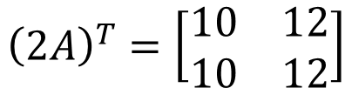

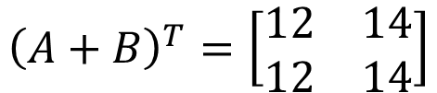
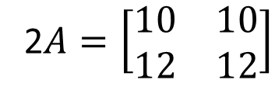
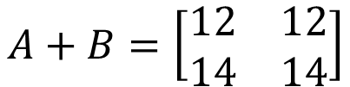

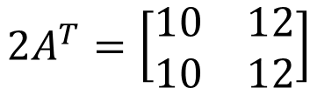
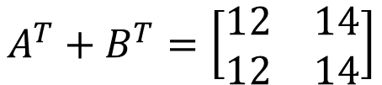



Transpose
$$A=\left[\begin{matrix}5 & 5 \\ 6 & 6\end{matrix}\right]$$
$$B=\left[\begin{matrix}7 & 7 \\ 8 & 8\end{matrix}\right]$$
A and B are mxn matrices, and s is a scalar
${\left(A^{T}\right)}^{T}=A$
${\left(sA\right)}^{T}=sA^{T}$
${\left(A+B\right)}^{T}=A^{T}+B^{T}$
2$A=\left[\begin{matrix}10 & 10 \\ 12 & 12\end{matrix}\right]$
$${\left(2A\right)}^{T}=\left[\begin{matrix}10 & 12 \\ 10 & 12\end{matrix}\right]$$
$$A^{T}=\left[\begin{matrix}5 & 6 \\ 5 & 6\end{matrix}\right]$$
$$2A^{T}=\left[\begin{matrix}10 & 12 \\ 10 & 12\end{matrix}\right]$$
$$A+B=\left[\begin{matrix}12 & 12 \\ 14 & 14\end{matrix}\right]$$
$${\left(A+B\right)}^{T}=\left[\begin{matrix}12 & 14 \\ 12 & 14\end{matrix}\right]$$
$$A^{T}=\left[\begin{matrix}5 & 6 \\ 5 & 6\end{matrix}\right]$$
$$B^{T}=\left[\begin{matrix}7 & 8 \\ 7 & 8\end{matrix}\right]$$
$$A^{T}+B^{T}=\left[\begin{matrix}12 & 14 \\ 12 & 14\end{matrix}\right]$$

